Slide 1

Welcome to
DPRW

Slide 2
Unit 5 Introduction
Unit 5

Slide 3

Agenda
I. Objectives
II. Lead-in Activities
III. Lecture
  IV. Follow-up Activity

Slide 4

I. Objectives
After the class, you should be able to:
I Understand the general functions of the introduction
2 Become familiar with the structural features of the introduction

Slide 5
II. Lead-in Activities
Read the introduction of your selected paper and then tell
1.what are included in the introduction.
2.what problems you found in reading.

Slide 6
III. Lecture
3.1 General Functions of the Introduction
3.2 Structural Features of the Introduction
3.3Tips for writing an introduction

Slide 7
General Functions of the Introduction
Every academic paper should have at least one or two introductory paragraphs with or without a particular subtitle.
The length or the degree of formality of the paper may decide if the introduction should be a separately-labeled section
Generally speaking, a successful introduction of a paper should have the following four functions.

Slide 8
General Functions of the Introduction
Introducing the Background of the Subject
When retrieving research information, a reader may skim the title, the abstract, and the introduction of a paper to determine whether or not the paper is worth reading.
The writer should therefore supply sufficient background information to the readers who are not well-prepared for the subject.
With the help of introduction, readers can understand the current research on the topic without referring to the previous publications.

Slide 9
General Functions of the Introduction
Showing the Research Scope
narrow down the scope of your study
include the range of parameters
cover exact sphere of the general subject

Slide 10
General Functions of the Introduction
Stating the General Purpose
tell the reader where to go.
Make clear the purpose and task of the paper
emphasize the primary objectives of the research.

Slide 11
General Functions of the Introduction
Explaining the Content Arrangement
let the reader know in advance what kinds of information to expect and in what order.
enable the reader to understand the structure of the paper more easily
The best place for this information is at the end of
introduction.
In short papers, such information is not necessary.

Slide 12
Exercises and Practice
Analyze the introduction below and explain how it functions. P 57
Background
Research Scope
General Purpose
Content Arrangement

Slide 13
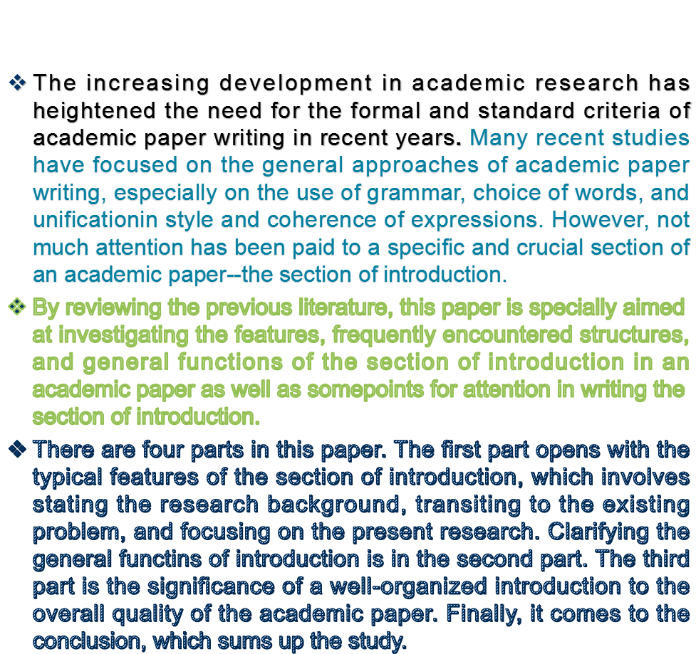

Slide 14
Structural Features of the Introduction
1.Starting with the Research Background: the recent developments in the relevant field
This paragraph briefly puts the subject of ID within its SLA and FLL
contexts, and shows the reader why there is a problem.
To learn a new language involves two contexts: One is Second Language Acquisition (SLA) where the learning of a non-native language is in the environment in which that language is spoken. This may or may not take place in a classroom setting. The other is Foreign Language Learning (FLL) where a foreign language is learned in a classroom setting in which curriculum, textbook and teaching method are involved (Gass, 1993) Educators and researchers found learners acquire different outcomes in the same context. The attention, therefore, turned to Individual Difference(ID). They tried to discover: In what way do language learners differ? How do learners’ differences affect the outcome of learning?

Slide 15
Introduce the background
1.Over the past several+time period…
2.The previous work on…has shown that…
3.Several researchers have investigated…
4.Industrial use of… is becoming increasingly common.
5. It is well-known that…
6.There gave been a few studies highlighting…

Slide 16
Structural Features of the Introduction
2.Narrowing Down to the Existing Problem
2.1.existing problems not mentioned before, 2.2.the methods not adopted so far,
2.3.materials not discovered in the past,
2.4.the factors previously ignored, and so on.

Slide 17
sample
By reviewing what has been done at home and abroad on the subject of ID study, the writer shows readers what has not been done. Skillfully, the writer narrows down his research to a problem, i.e. ID study on non-English majors.
The study abroad started in the 1950s and early 70s saw substantial work on motivation. At present, the study of ID focuses on the influence of cognitive elements and learning strategies upon English as a Foreign Language(EFL), which can help us have a deeper understanding of the SLA process.
Compared with the research abroad, not much research has been done at home. In 1993, Beijing Foreign Studies University initiated the ID study among English majors(Liu Runqing, 1993) The research did achieve a lot by profiling a hypothesized successful EFL learner and providing new insights for the study in this area. However, not much study on non-English majors has been devoted to ID.

Slide 18
Present existing problems
1.Great progress has been made in this field. However,…
2.No clear advancement has so for been seen in…
3.No direct outcome was then reported in….
4.No such finding could be available in…
5.So far there is not enough convincing evidence showing…
6.The data in …. failed to prove that…
7.The theory of… did not explain how many modifications arose
8….. However, …. remains unsolved.
9…..yet….has frequently been questioned because….
10.No ….in this field has suggested that….

Slide 19
Structural Features of the Introduction
3.Focusing on the Present Research
Turn the reader’s attention to the present research, by stating primary research objectives, novel ideas, advanced methods, new materials, and so on.

Slide 20
sample
The following thesis statement of the study is presented and the content arrangement also introduced to make it easy for readers to follow.
The present study, therefore, is an attempt to figure out some factors in predicting success in EFL among non-English majors in Tsinghua University [thesis statement]
The paper is divided into five major parts as follows. The thesis opens with the introduction, introducing… Part Two develops the prop theory, and the design of the survey and the data collection is given in the last part of the thesis. [content arrangement]

Slide 21
Tips for writing an introduction
1.Follow the order of background, subject, problem, thesis statement, and content arrangement to organize your introduction.
2.Employ effective openings to develop your introduction, e.g. by relating well-known facts, reviewing the literature, taking exception to critical views, challenging an assumption, defining key terms, etc.
3.Avoid complex and difficult questions
4. Don’t to provide details;
5. Make best use of the idiomatic expressions.

Slide 22
IV. Follow-up Activity
Read the introduction below and highlight those expressions which indicate the research background, existing problems, research purpose, as well as the content arrangement. P62-2
Start to write an introduction of your paper

Slide 23
Thank You !

